Slide 1
SOFTWARE TESTING

Slide 2
What is Software Testing?
It’s a activity to check whether the actual result matches the expected result.
It can be done by Manually or automated tools.

Slide 3
Principles
Testing shows presence of defects.
Exhaustive testing is not possible.
Early testing.
Defect clustering.
Pesticide paradox.
Testing is context dependent.
Absence of errors fallacy

Slide 4

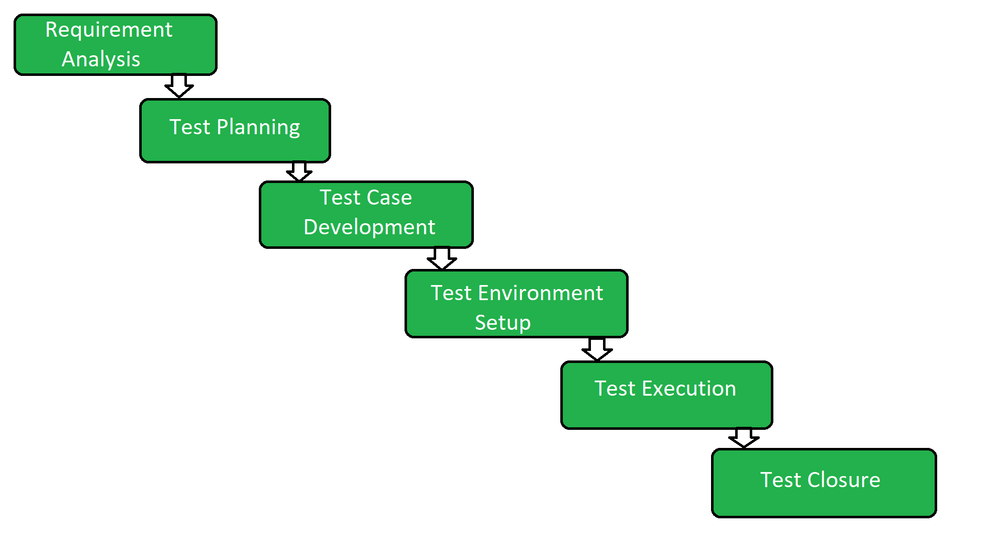



Software Testing Life Cycle

Slide 5
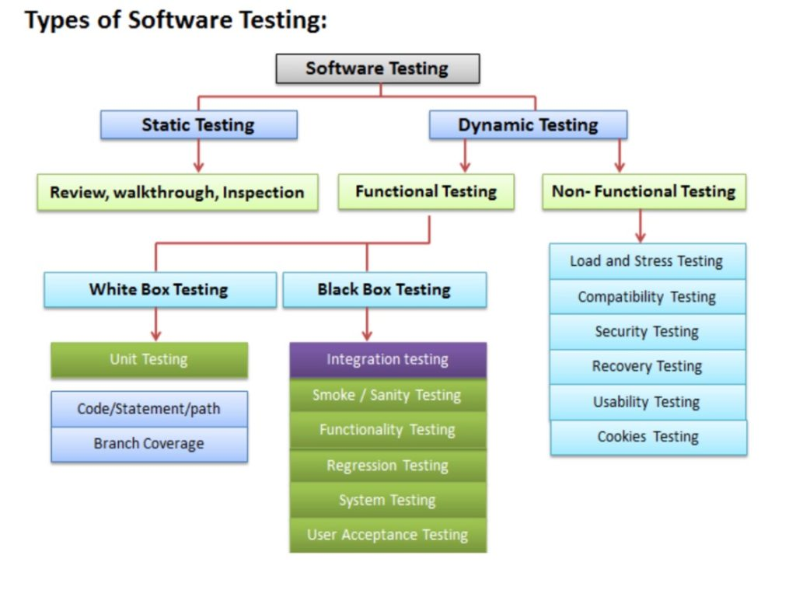
Types of Software Testing

Slide 6
Manual vs Automation Testing
Parameters | Manual | Automation
Definition | Automation Testing uses automation tools to execute test cases. | In manual testing, test cases are executed by a human tester and software.
Processing time | Automated testing is faster than a manual approach. | Manual testing is time-consuming
Reliability | Automated testing is a reliable method, as it is performed by tools and scripts. | Manual testing is not as accurate because of the possibility of the human errors.
When to Use? | Automated Testing is suited for Regression Testing, Performance Testing or highly repeatable functional test cases. | Manual Testing is suitable for Exploratory, Usability and Adhoc Testing.

Slide 7
THANKYOU

